Slide 1
Principles of the Software Design
Course for Armenian-French University
Areg Melik-Adamyan
Petr Kurapov

Slide 2
Lecture 1: Course Introduction
Course for Armenian-French University (Lyon University)
Areg Melik-Adamyan
Petr Kurapov

Slide 3
Agenda
Overview
Course Logistics
Programming and Software Design
Engineering and Software Design
Software Design and Architecture

Slide 4
Course Overview
This course on the principles and methodology of software design and its applications in building software systems.
This is not about programming or how to use programming language to code an algorithms

Slide 5
Course Outline
Language of the Desing
System Decomposition
Abstraction Creation
Synthesis
Building systems

Slide 6
Course Logistics
Course Policies and Schedule
Refer to the course page
Lots of readings and homework
Cheating will not help, the final exam is the most important.
All discussions and announcements will be on Discord

Slide 7

Textbook
There is no single book to cover everything.
The list of readings are in the syllabus.
Most of the stuff is a synthesis from books, articles and experience
This will be the main

Slide 8
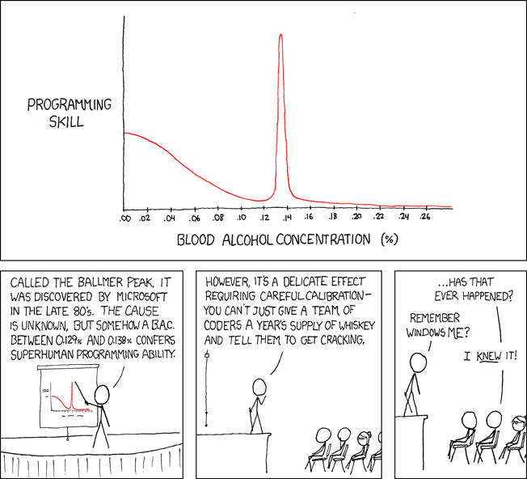
How to write great programs?
https://www.explainxkcd.com/wiki/index.php/323:_Ballmer_Peak

Slide 9
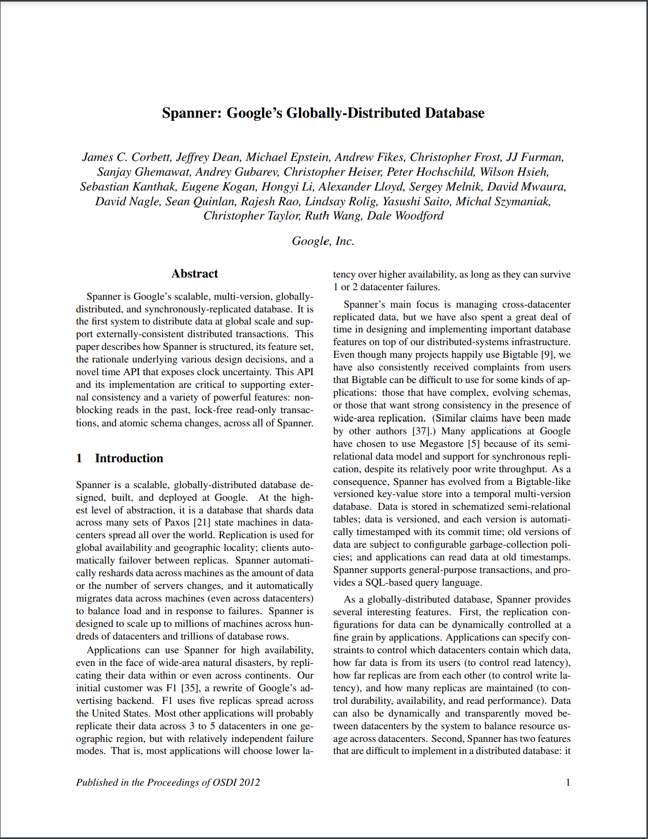
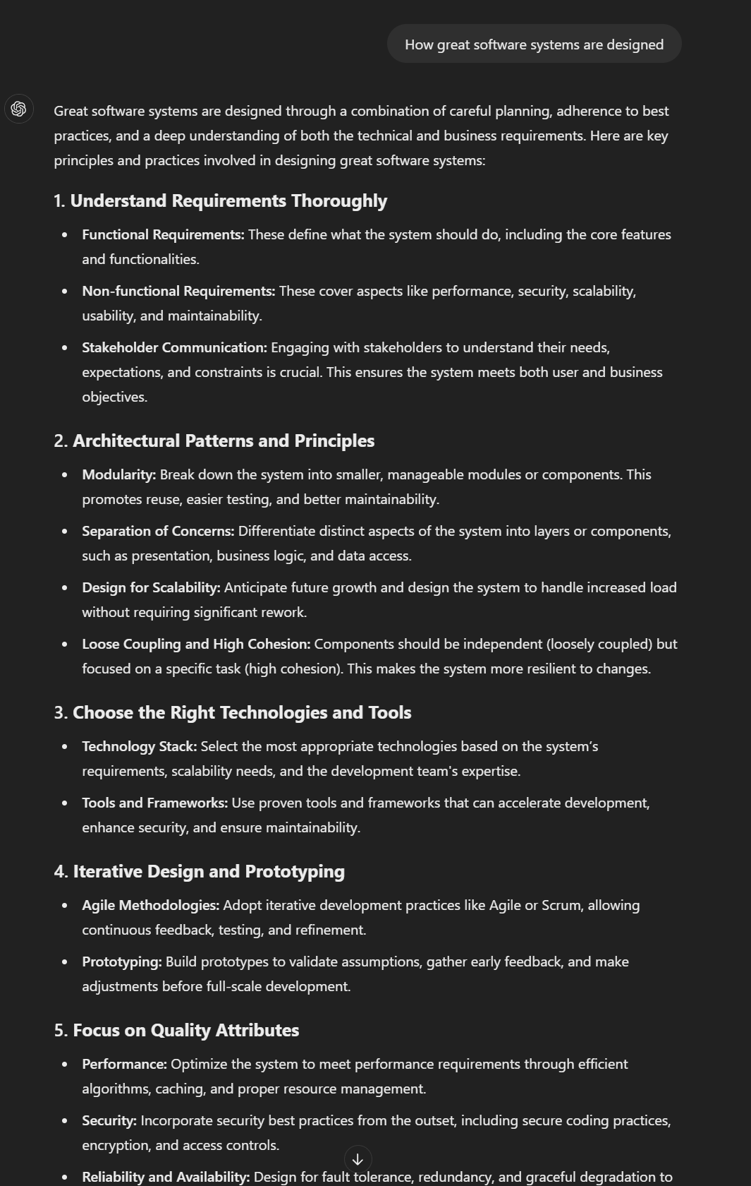
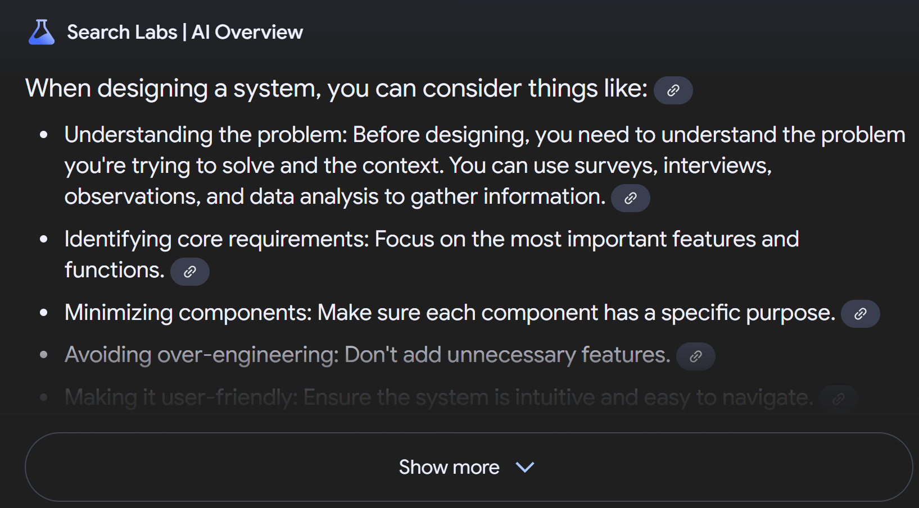
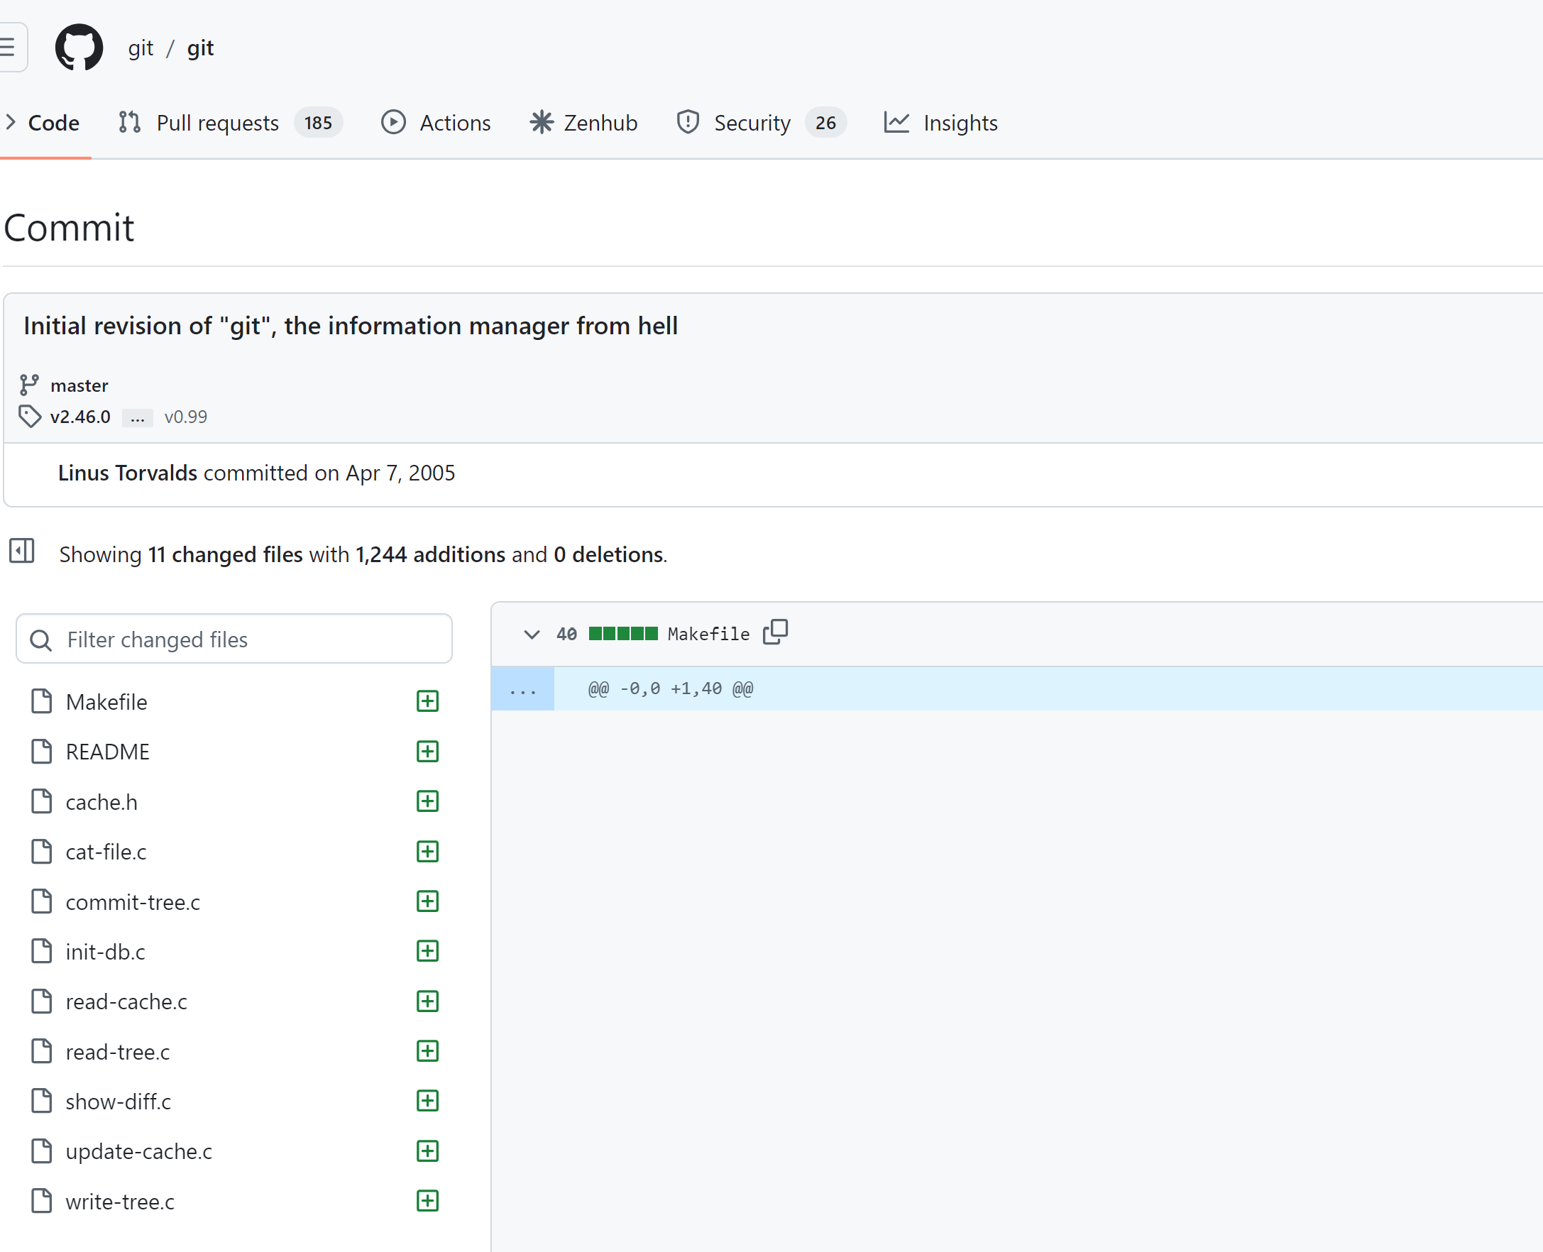
How to design great systems?

Slide 10
Great systems == great architects
How to become a great software programmer and architect?
Need to develop the appropriate mentality – the ability to step back and refine important from non-important stuff.
How are we going to learn that?
E.W.D Dijkstra, 1975 “The problem with today's mathematical curricula is that mathematical results are published and taught quite openly, but how mathematics is done is not published, not taught explicitly, and the student must pick it up by osmosis so to speak.”
We are going to study some designs.
But first, we need to start speaking the same “language of design”.

Slide 11
It’s all About Complexity
“… But programming, when stripped of all its circumstantial irrelevancies, boils down to no more and no less than very effective thinking so as to avoid unmastered complexity, to the very vigorous separation of your many different concerns.” E.W.D, 1975.
What is software design/architecture?
Many definitions, will use many of them, one of most popular from SEI
“The software architecture is a set of structures needed to reason about the system, which comprise software elements, relations among them and properties of both.”
(Clements et al., 2010)

Slide 12
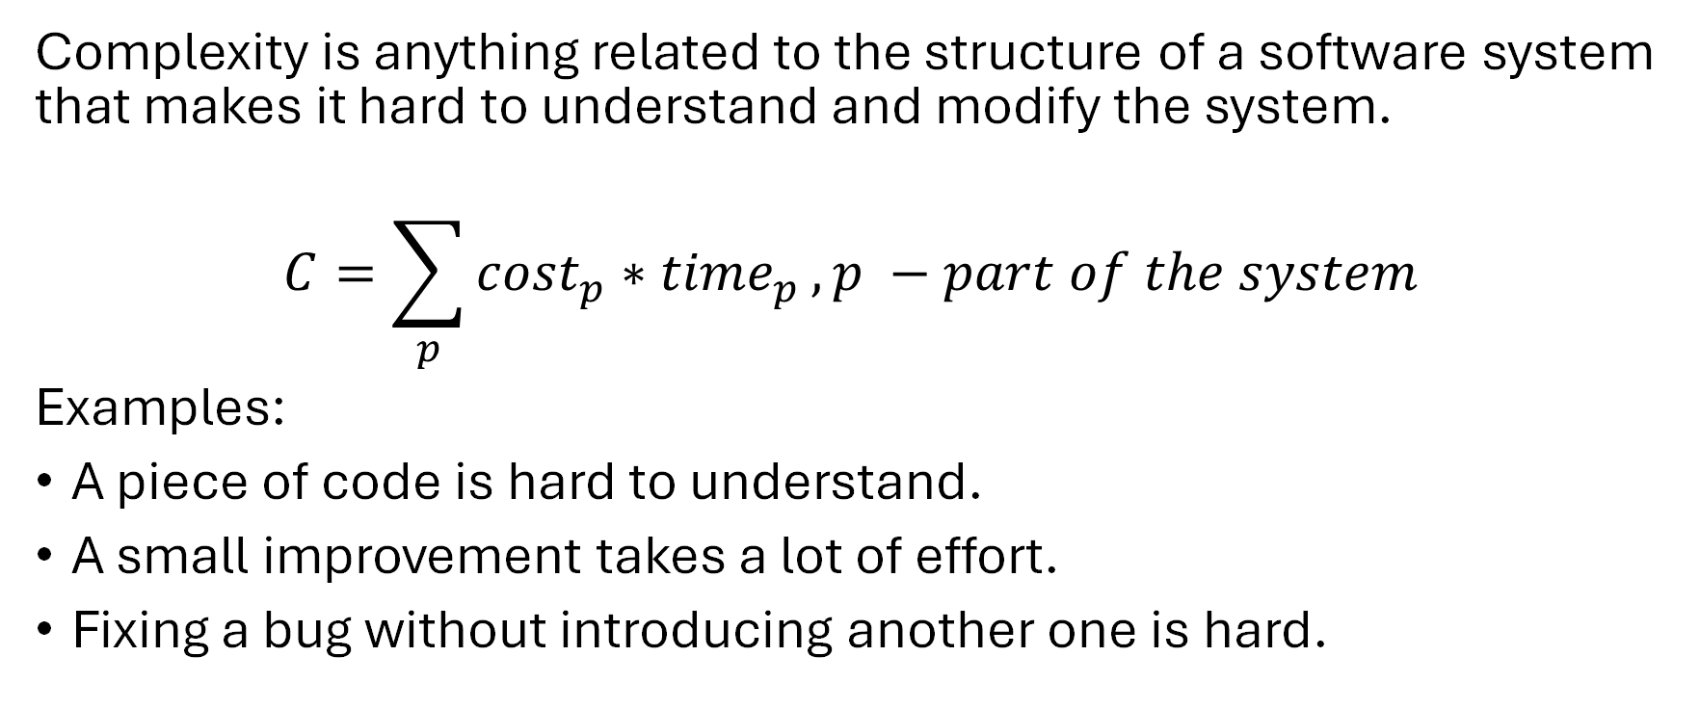
Complexity definition
Complexity is anything related to the structure of a software system that makes it hard to understand and modify the system.
$$C=\sum_{p}{{cost}_{p}∗{time}_{p}}, p −part of the system$$
Examples:
A piece of code is hard to understand.
A small improvement takes a lot of effort.
Fixing a bug without introducing another one is hard.

Slide 13
Symptoms of complexity
Change amplification
Example (#ifdef CUDA!!)
Cognitive load
Example (global variables, module dependencies – data mgr in hdk)
Lines of code is not a good measure!!
Unknown unknowns – something you need to know, but there’s no way of finding out what it is
Example (smth like a lack of dependency on a global-ish setting; options!! Update of the option by some rule that’s not apparent)

Slide 14
Causes of complexity
Dependencies – a piece of code cannot be understood or modified in isolation.
Example 1: method signature.
Example 2: serialization & deserialization.
Obscurity – important information is not obvious.
Example 1: variable name (time) or inadequate documentation.
Example 2: Error status & messages.
Complexity is incremental: thousands of small dependencies and obscurities introduced by current changes

Slide 15
Design and Architecture
Design is both verb and noun - process and result.
We will use Design and Architecture interchangeably.
Differ from Detailed-level design
What is driving design?
Decision to transform purpose – requirements (functional, non-functional, quality, constraints) are called architectural or design drivers.

Slide 16
Architectural Design
We talked about complexity, what else?
Decisions and intentions – forced by drivers.
Need to stay at a certain level of abstraction – not to get into detailed design.
What is detailed design?
Naming patterns, usage of Pthreads, usage of QUIC, etc.

Slide 17
Why is Software Design Important?
Design and architecture acts as the skeleton of a system.
Every system has an architecture. There is no single right architecture.
Architecture influences quality attributes.
External properties (latency, security, etc.) differently manifest in different skeletons.
Architecture is orthogonal to functionality!!!
E.g., you can build the same system as 3-tier, 2 tier or P2P.
Architecture constraints systems
Art to tame the complexity to have the right level of attributes.

Slide 18
When is Architecture Important?
Small solution space.
High risk of failure
Difficult quality attributes
New Domain
Product lines

Slide 19
How should we use it?
Approach | Description
Architecture indifferent design | You pay little attention to architecture. Your system may become a big ball of mud, a distinct architecture may emerge without your conscious choice, or you may be guided by norms in your domain to a presumptive architecture.
Architecture focused design | You deliberately choose your software architecture. You design an architecture that is suitable to achieve your goals, which include functionality and quality attributes.
Architecture hoisting | A kind of architecture-focused design in which developers design the architecture with the intent of guaranteeing a goal or property of the system. Once a goal or property has been hoisted into the architecture, developers should not need to write any additional code to achieve it.

Slide 20
Homework
Find the initial Git commit by Linus Torvalds, read the code, and build the conceptual model of the initial design.
What was the problem?
What were the requirements?
What were the constraints?
What were the explicit design decisions made?
Need to write a paper answering these questions.
Extra points if you add – what is wrong with Git?

